Slide 1
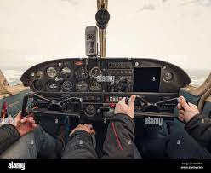
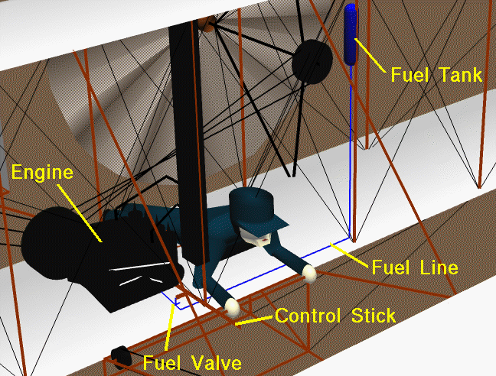
Project Propel: Tech & AI Enabled Project Re-Engineering for Speed and Agility
Vish K. and Arjun B.

Slide 2
ROADMAP
Discussion of Project CoPilot Effort
Demo of a Quick AI System
Discussion on Next Steps
Notes:
A lot of my own thoughts about strategic thinking were developed about 10 years ago when I did a pretty thorough review about what the business world and fields of cognitive psychology and economic decision theory could teach social change organizations about strategic thinking.
So, as I gathered my thoughts before this training, I did some quick internet searches to learn what new developments there might be. A quick stop at Wikipedia was not at all encouraging. This slide is a direct quote from one of the first paragraphs of the entry on strategic thinking.
In fact, the entry goes on to say that about the only thing most experts agree upon is that traditional models of strategy making (primarily based on strategic planning processes) are not working.

Slide 3



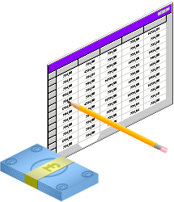









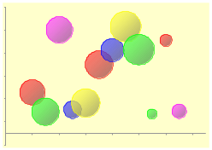

The Project Hustle-Bustle
Resource Mgmt/Procurement
New Project
New Project
Tracking/Forecasting
New Project
Reporting
Risk scanning
Project Delivery
Contract Mgmt
Project Planning
& Budgeting
Portfolio Planning
Revenue
Project/Program Manager

Slide 4





Enterprise Project Co-Pilot
Letter of Award
Scope
Schedule
Terms
Project Reporting
Project Planning
Metrics
KPIs
Reports
Setup systems
Review Risks
Work
Resources
Finances
Project Control
Project Execution
Updates
Forecasts
Changes
Billings
Capitalization
Progress
Documents
Issues
Actuals

Slide 5
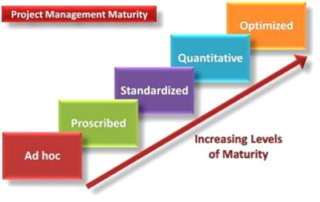
Project Management Is Particularly Challenging …

Slide 6
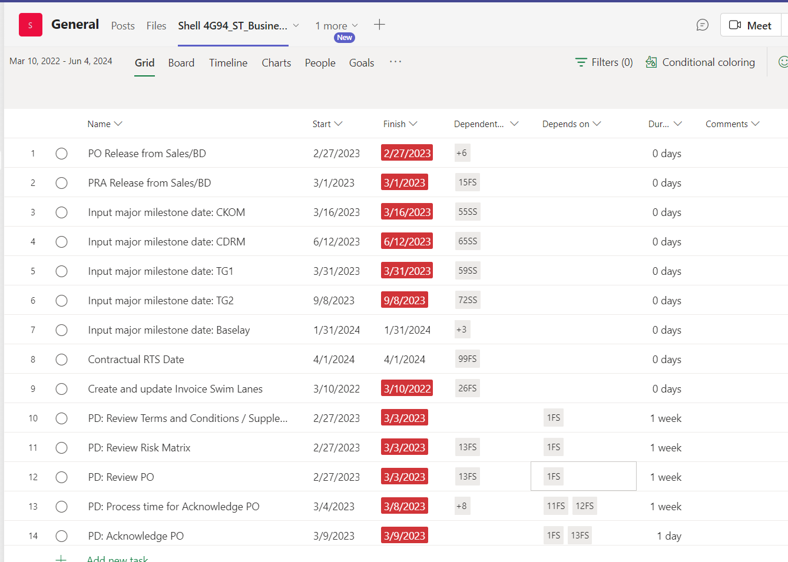
Digital Twin

Slide 7
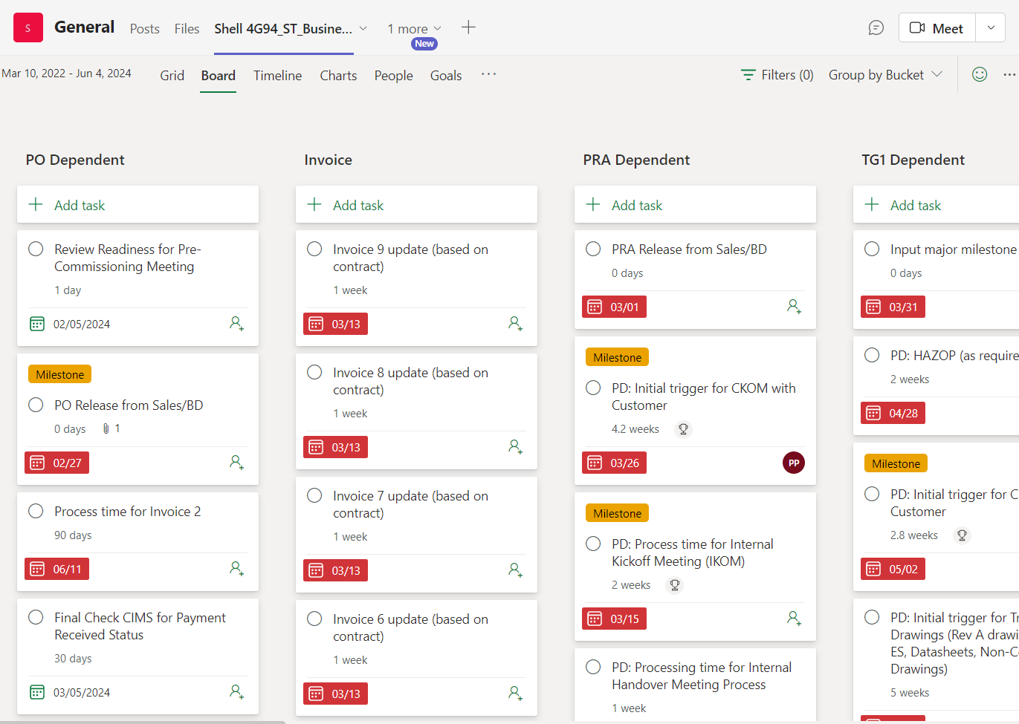
Digital Twin

Slide 8
DIGITAL TWIN BENEFITS
Consistent Approach
Notifications for key events (potentially tied to governance)
Automation of Key Activities
Notes:
A lot of my own thoughts about strategic thinking were developed about 10 years ago when I did a pretty thorough review about what the business world and fields of cognitive psychology and economic decision theory could teach social change organizations about strategic thinking.
So, as I gathered my thoughts before this training, I did some quick internet searches to learn what new developments there might be. A quick stop at Wikipedia was not at all encouraging. This slide is a direct quote from one of the first paragraphs of the entry on strategic thinking.
In fact, the entry goes on to say that about the only thing most experts agree upon is that traditional models of strategy making (primarily based on strategic planning processes) are not working.

Slide 9

CO-PILOT GEAR
From PO, PRA, Scope
Generate- Digital Twin, Schedule,
Extract - Milestones, Invoice events, Other key phrases/info
Automate – Communication, coordination, notifications
Review continuously – Schedule risks, Parts shortages, Task delays
Notes:
A lot of my own thoughts about strategic thinking were developed about 10 years ago when I did a pretty thorough review about what the business world and fields of cognitive psychology and economic decision theory could teach social change organizations about strategic thinking.
So, as I gathered my thoughts before this training, I did some quick internet searches to learn what new developments there might be. A quick stop at Wikipedia was not at all encouraging. This slide is a direct quote from one of the first paragraphs of the entry on strategic thinking.
In fact, the entry goes on to say that about the only thing most experts agree upon is that traditional models of strategy making (primarily based on strategic planning processes) are not working.

Slide 10
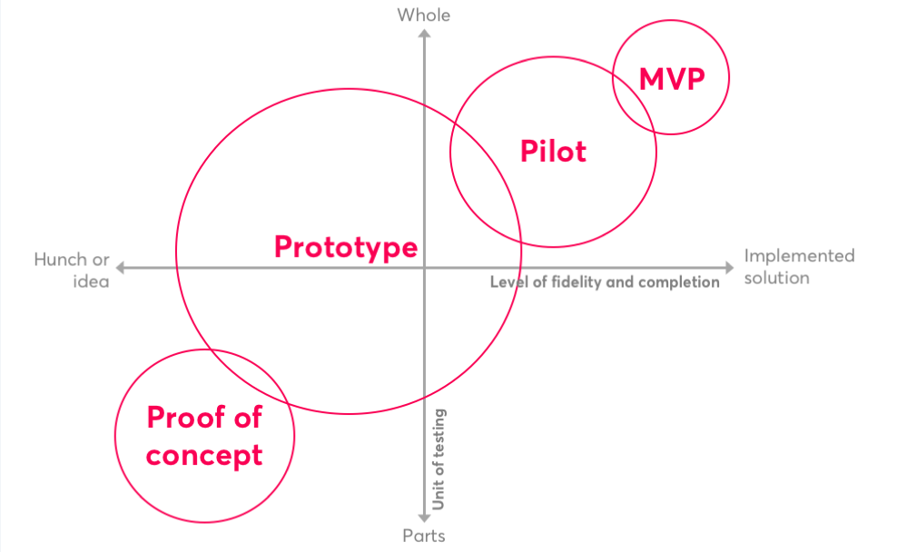
Demo of Proof of Principle/Concept
From PO, PRA, Scope Generate- Digital Twin, Schedule,
Extract - Milestones, Invoice events, Other key phrases/info
Automate – Communication, coordination, notifications
Review continuously – Schedule risks, Parts shortages, Task delays
Notes:
A lot of my own thoughts about strategic thinking were developed about 10 years ago when I did a pretty thorough review about what the business world and fields of cognitive psychology and economic decision theory could teach social change organizations about strategic thinking.
So, as I gathered my thoughts before this training, I did some quick internet searches to learn what new developments there might be. A quick stop at Wikipedia was not at all encouraging. This slide is a direct quote from one of the first paragraphs of the entry on strategic thinking.
In fact, the entry goes on to say that about the only thing most experts agree upon is that traditional models of strategy making (primarily based on strategic planning processes) are not working.

Slide 11
PROPEL -> GEAR
Extract - Milestones, Invoice events, Other key phrases/info
Automate – Communication, coordination, notifications
EXTRACT INFO ABOUT PO
AUTOMATE CRITICAL PATH AND POPULATE START DATES
POPULATE EXCEL WITH PAYMENT MILESTONE DATA
GENERATE MONTHLY REPORTS WITH ALL DATA FROM EXCEL
Notes:
A lot of my own thoughts about strategic thinking were developed about 10 years ago when I did a pretty thorough review about what the business world and fields of cognitive psychology and economic decision theory could teach social change organizations about strategic thinking.
So, as I gathered my thoughts before this training, I did some quick internet searches to learn what new developments there might be. A quick stop at Wikipedia was not at all encouraging. This slide is a direct quote from one of the first paragraphs of the entry on strategic thinking.
In fact, the entry goes on to say that about the only thing most experts agree upon is that traditional models of strategy making (primarily based on strategic planning processes) are not working.

Slide 12
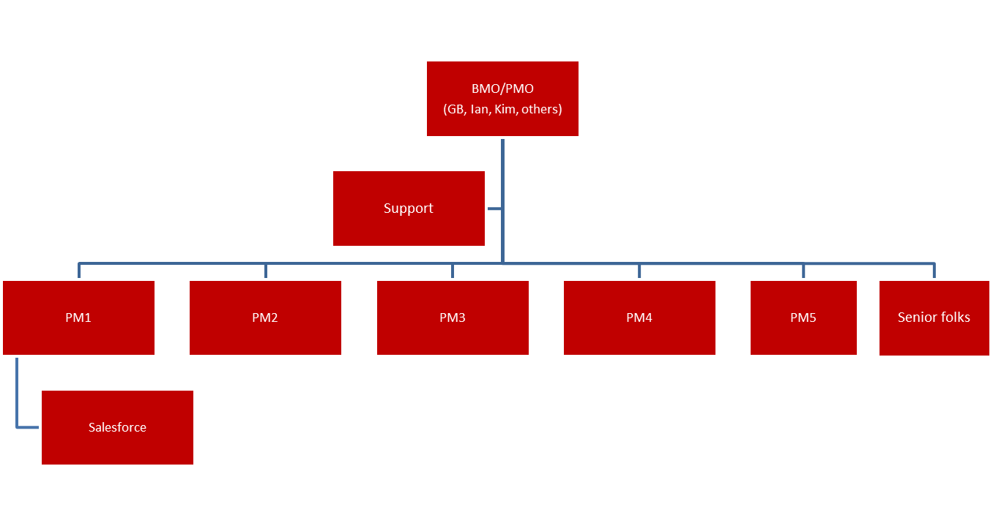
Org chart Proposal
A lean
Propel Co-Pilot
(Phase 1, Digital twin; Phase 2- Co-Pilot)
PSS
Baan

